Slide 1
Azure Cosmos DB Globally distributed, multi-model database service
<Speaker>
<date>

Slide 2
Modern apps face new challenges
Managing and syncing data distributed around the globe
Delivering highly-responsive, real-time personalization
Processing and analyzing large, complex data
Scaling both throughput and storage based on global demand
Offering low-latency to global users
Modernizing existing apps and data
Notes:
*watch Rimma’s video for context and talking points <<need link>> Azure Cosmos DB vision is to be the database for all planet-scale applications and scenarios.
The picture I want you to take away is this.
Build planet-scale databases without worry.
Model the data the way your application needs it to be.
Use the API, tools and framework that you are familiar with.

Slide 3





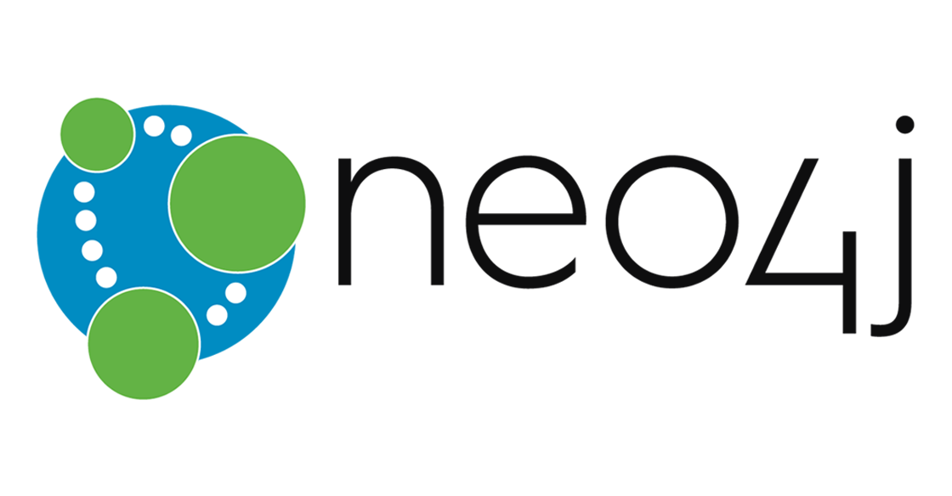
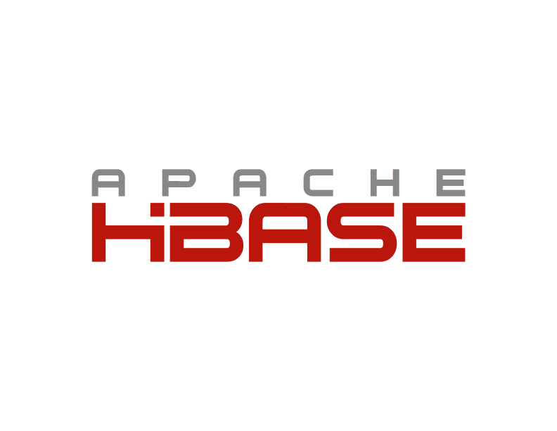




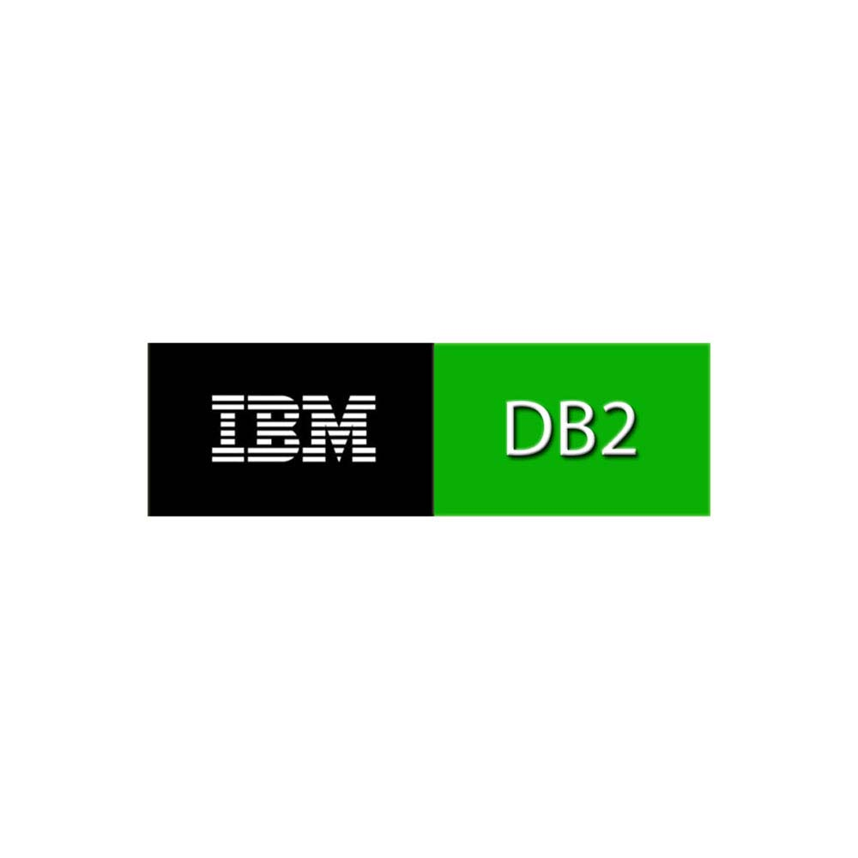
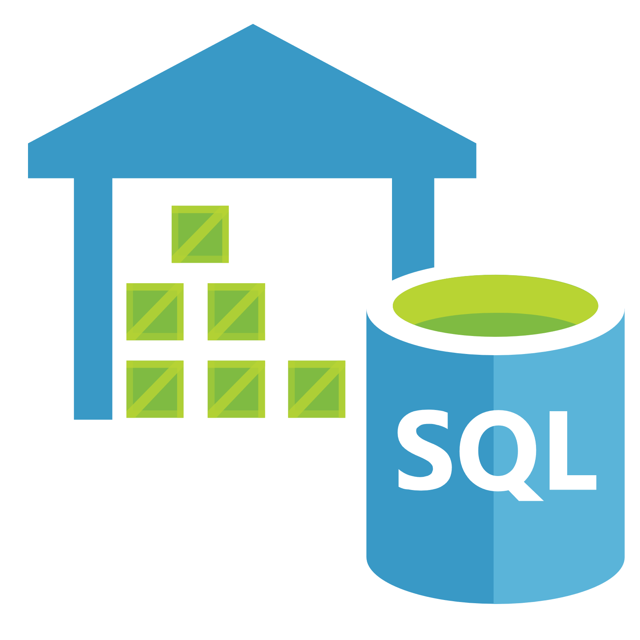








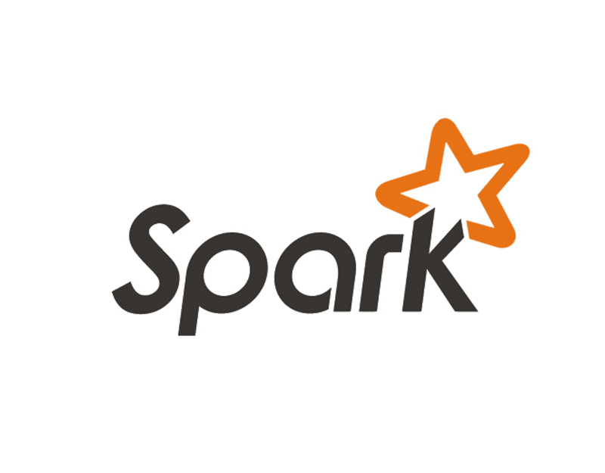
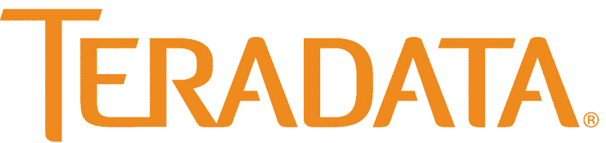

Which database?
High Concurrency
Schema-Bound
Schema-Less
HDInsight
Low Concurrency

Slide 4
NoSQL Options
Cloudstore
DynamoDB

Slide 5
Azure Cosmos db
A FULLY-MANAGED GLOBALLY DISTRIBUTED DATABASE SERVICE BUILT TO GUARANTEE
EXTREMELY LOW LATENCY AND MASSIVE SCALE FOR MODERN APPS

Slide 6
Why Customers Choose Cosmos DB
Azure Cosmos DB was built to support modern app patterns and use cases.
It enables industry-leading organizations to unlock the value of data, and respond to global customers and changing business dynamics in real-time.
Data can be globally distributed for reads and writes at the push of a button
Nearly infinite scale allows applications to be available at the most critical times
Single millisecond latency with industry leading SLAs to back it
Cloud infrastructure reduces administrative overhead of running a distributed system
Support for open source APIs allows existing software to easily be migrated to Cosmos DB
Native support for different data structures and programming languages

Slide 7
Powering global solutions
Azure Cosmos DB was built to support modern app patterns and use cases.
It enables industry-leading organizations to unlock the value of data, and respond to global customers and changing business dynamics in real-time.
Data distributed and available globally
Build real-time customer experiences
Ideal for gaming, IoT & eCommerce
Simplified development with serverless architecture
Run Spark analytics over operational data
Lift and shift NoSQL data
Puts data where your users are
Enable latency-sensitive personalization, bidding, and fraud detection.
Predictable and fast service, even during traffic spikes
Fully-managed event-driven micro-services with elastic computing power
Accelerate insights from fast, global data
Lift and shift MongoDB and Cassandra workloads

Slide 8



What is Azure Cosmos DB
A globally distributed, massively scalable, multi-model database service
Table API
MongoDB
SQL
Key-value
Column-family
Document
Graph
Guaranteed low latency at the 99th percentile
Elastic scale out
of storage & throughput
Five well-defined consistency models
Turnkey global distribution
Comprehensive SLAs

Slide 9
Turnkey global distribution
PUT YOUR DATA WHERE YOUR USERS ARE IN MINUTES
Automatically replicate all your data around the world, and across more regions than Amazon and Google combined.
Available in all Azure regions
Manual and automatic failover
Automatic & synchronous multi-region replication
Notes:
Elastic Scale out -> Tunable Consistency
Small storage – large throughput (e.g. notification broadcast/poll)
Large storage – small throughput (e.g. classic data/log store)

Slide 10
ELASTIC SCALE OUT OF STORAGE AND THROUGHPUT
SCALES AS YOUR APPS’ NEEDS CHANGE
Independently and elastically scale storage and throughput across regions – even during unpredictable traffic bursts – with a database that adapts to your app’s needs.
Elastically scale throughput from 10 to 100s of millions of requests/sec across multiple regions
Support for requests/sec for different workloads
Pay only for the throughput and storage you need
Notes:
Elastic Scale out -> Tunable Consistency
Small storage – large throughput (e.g. notification broadcast/poll)
Large storage – small throughput (e.g. classic data/log store)

Slide 11
GUARANTEED LOW LATENCY
PROVIDE USERS AROUND THE WORLD WITH FAST ACCESS TO DATA
Serve <10 ms read and <15 ms write requests at the 99th percentile from the region nearest to users, while delivering data globally.
Notes:
Single digit latency -> SLA

Slide 12
FIVE WELL-DEFINED CONSISTENCY MODELS
CHOOSE THE BEST CONSISTENCY MODEL FOR YOUR APP
Offers five consistency models
Provides control over performance-consistency tradeoffs, backed by comprehensive SLAs.
An intuitive programming model offering low latency and high availability for your planet-scale app.
Strong
Bounded-stateless
Session
Consistent prefix
Eventual
Notes:
Tunable Consistency -> Single digit latency
Bounded Staleness - Consistent Prefix. Reads lag behind writes by k prefixes or t interval
Session - Consistent Prefix. Monotonic reads, monotonic writes, read-your-writes, write-follows-reads
Consistent Prefix - Updates returned are some prefix of all the updates, with no gaps

Slide 13
Multiple data models and apis
USE THE MODEL THAT FITS YOUR REQUIREMENTS, AND THE APIS, TOOLS, AND FRAMEWORKS YOU PREFER
Cosmos DB offers a multitude of APIs to access and query data including, SQL, various popular OSS APIs, and native support for NoSQL workloads.
Use key-value, tabular, graph, and document data
Data is automatically indexed, with no schema or secondary indexes required
Blazing fast queries with no lag
Table API
MongoDB
SQL
Column-family
Document
Key-value
Graph
Notes:
Multi – Model -> Elastic Scale out
No need to convert you data to meet any particular model

Slide 14
COMPREHENSIVE SLAs
RUN YOUR APP ON WORLD-CLASS INFRASTRUCTURE
Azure Cosmos DB is the only service with financially-backed SLAs for millisecond latency at the 99th percentile, 99.999% HA and guaranteed throughput and consistency
Latency
HA
Throughput
Consistency
<10 ms
99.999%
Guaranteed
Guaranteed
99th percentile
Notes:
HA 99.999% for multi-region read; 99.99% for single region deployments

Slide 15
Handle any data with no schema or indexing required
Azure Cosmos DB’s schema-less service automatically indexes all your data, regardless of the data model, to delivery blazing fast queries.
Automatic index management
Synchronous auto-indexing
No schemas or secondary indices needed
Works across every data model
GEEK
Item | Color | Microwave safe | Liquid capacity | CPU | Memory | Storage
Geek mug | Graphite | Yes | 16ox | ??? | ??? | ???
Coffee Bean mug | Tan | No | 12oz | ??? | ??? | ???
Surface book | Gray | ??? | ??? | 3.4 GHz Intel Skylake Core i7-6600U | 16GB | 1 TB SSD
Notes:
Look at Andrew’s “variety” slide
Automatic and synchronous indexing of all ingested content - hash, range, geo-spatial, and columnar
No schemas or secondary indices ever needed
Resource governed, write optimized database engine with latch free and log structured techniques
Online and in-situ index transformations
While the database is fully schema-agnostic, schema-extraction is built in
Customers can get Avro schemas from the database

Slide 16
Trust your data to industry-leading Security & Compliance
Azure is the world’s most trusted cloud, with more certifications than any other cloud provider.
Enterprise grade security
Encryption at Rest
Encryption is enabled automatically by default
Comprehensive Azure compliance certification
Notes:
Encryption at Rest
Always encrypted at rest and in motion
Data, index, backups, and attachments encrypted
Encryption is enabled automatically by default
No impact on performance, throughput or availability
Transparent to your application
Comprehensive Azure compliance certification
ISO 27001, ISO 27018, EUMC, HIPAA, PCI
SOC1 and SOC2 (Audit complete, Certification in Q2 2017)
FedRAMP, IRS 1075, UK Official (IL2) (Q2 2017)
HITRUST (H2 2017)

Slide 17


Data distributed and available globally
Put your data where your users are to give real-time access and uninterrupted service to customers anywhere in the world.
Turnkey global data replication across all Azure regions
Guaranteed low-latency experience for global users
Resiliency for high availability and disaster recovery
Azure region A
<10 ms
Azure Cosmos DB (app + session state)
Browser
Azure Traffic Manager
Azure region B
<10 ms
Globally distributed across regions
Azure region C
<10 ms
Notes:
Franchise across globe. High latency of app for ordering pizza
Moved app to AWS but achieved low consistency across databases followed by a big downtime.
Sell you convenience. Pizza as fast as you can.
Multimaster Cosmos DB and redundancy: Super Bowl if one region goes down they failover to another region

Slide 18



Build Real-Time Customer experiences
Online Recommendations Service
HOT path
Offer latency-sensitive applications with personalization, bidding, and fraud-detection.
Machine learning models generate real-time recommendations across product catalogues
Product analysis in milliseconds
Low-latency ensures high app performance worldwide
Tunable consistency models for rapid insight
Azure Service Fabric
(Personalization Decision Engine)
Azure Cosmos DB
(distributed model store)
Azure Data Factory
(scheduled job to refresh persisted models)
Shoppers
.com
(Product Details Page)
Azure Event Hub
Azure Data Lake Storage
(offline raw data)
Apache Spark on Azure Databricks
Offline Recommendations Engine COLD path
Notes:
Personalisation: every 100ms reduces traffic to your website so you don’t have time for a spark job to return. Threshold for user experience is 200ms. Cosmos db gives 10ms latency. Gives you 190ms for recommendation.

Slide 19


Ideal for gaming and ecommerce
Maintain service quality during high-traffic periods requiring massive scale and performance.
Instant, elastic scaling handles traffic bursts
Uninterrupted global user experience
Low-latency data access and processing for large and changing user bases
High availability across multiple data centers
Azure CDN
Azure Storage (Game files)
Azure API Apps (Game backend)
Azure Cosmos DB (Game database)
Azure HDInsight (Game analytics)
Azure Functions
Azure Notification Hub (Push notifications)

Slide 20





Massive Scale Telemetry Stores for IOT
Diverse and unpredictable IoT sensor workloads require a responsive data platform
Seamless handling of any data output or volume
Data made available immediately, and indexed automatically
High writes per second, with stable ingestion and query performance
Azure IoT Hub
Apache Storm on Azure HDInsight
Azure Cosmos DB
(Telemetry & device state)
Azure Web Jobs (Change feed processor)
Azure Storage (archival)
Logic apps

Slide 21
simplified development with serverless architecture
Azure Functions
(E-commerce Checkout, API)
Azure Cosmos DB
(Order event score)
Experience decreased time-to-market, enhanced scalability, and freedom from framework management with event-driven micro-services.
Real-time, resilient change feeds logged forever and always accessible
Native integration with Azure Functions
Change feed
Azure Functions
(Microservice 1: Tax)
Azure Functions
(Microservice 2: Payment)
Azure Functions
(Microservice N: Fulfillment)

Slide 22


Run spark over operational data
Accelerate analysis of fast-changing, high-volume, global data.
Real-time big data processing across any data model
Machine learning at scale over globally-distributed data
Speeds analytical queries with automatic indexing and push-down predicate filtering
Native integration with Spark Connector
Data nodes
Master node
Gateway nodes
Spark-Cosmos DB connector (Java)
Worker nodes

Slide 23

Lift and shift nosql apps
Make data modernization easy with seamless lift and shift migration of NoSQL workloads to the cloud.
Azure Cosmos DB MongoDB API and Cassandra API bring app data from existing MongoDB and Cassandra deployments
Leverage existing tools, drivers, and libraries, and continue using existing apps’ current SDKs
Turnkey geo-replication
No infrastructure or VM management required
NoSQL wire protocol
MongoDB
Azure Cosmos DB MongoDB API
Azure Cosmos DB Cassandra API

Slide 24

Initial Customer Audience
Traditional Data Opportunities
Database Administrators
BI Architects
Data Scientists
Data Engineers
NoSQL Opportunities
Application Architects
Product Development
vs.
Ongoing Support

Slide 25
Azure cosmos db
A globally distributed, massively scalable, multi-model database service.
Multi-model data with your favorite API
Elastically scale storage and throughput
Multiple, well-defined consistency levels
<10ms latency guarantees at the 99th percentile
Industry-leading SLAs across performance, latency, availability and throughput
Lift and shift MongoDB apps
Run Spark over operational data
Build real-time customer experiences
Ideal for IoT, gaming and eCommerce

Slide 26

GLOBAL APPS NEED GLOBAL DATA FROM A SERVICE THAT’S OUT OF THIS WORLD
WELCOME TO AZURE COSMOS DB
Start free // www.CosmosDB.com

